Slide 1
Using the Pink Cat Games Website at Home
Dear Parent,
In our class we play online games from www.pinkcatgames.com to help us practice math and language skills. Your child can play these games at home to help reinforce what they are learning at school.
To access the games that the teacher setup for your child, type this link into your web browser: <insert Student View link here>
This link will take you to the same webpage that your child sees when they play at school.
To make it easy for your child to access their games, you can create a shortcut on your computer, iPad or iPhone. Instructions for how to create a shortcut are on the following pages.
Page 2 – How to Create a Shortcut on an iPad or iPhone
Page 3 – How to Create a Desktop Shortcut on a Windows Computer
Page 4 – How to Create a Desktop Shortcut on a Mac Computer
Have fun playing and learning!

Slide 2
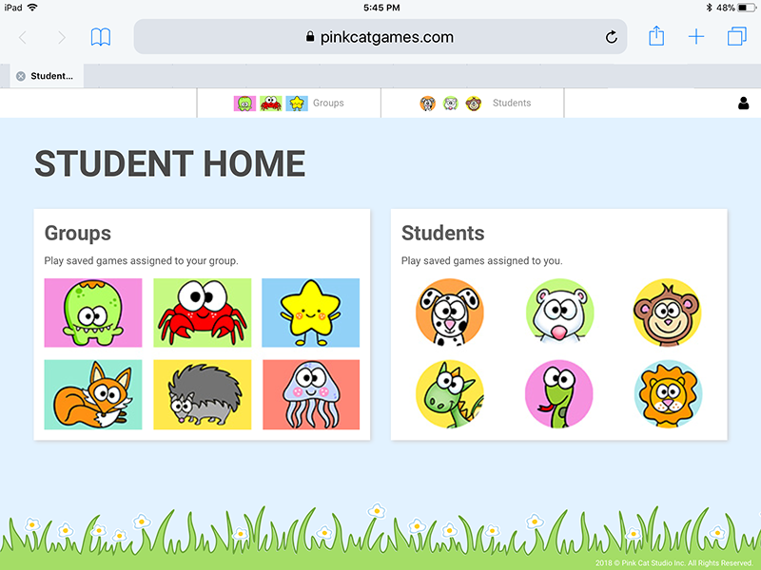
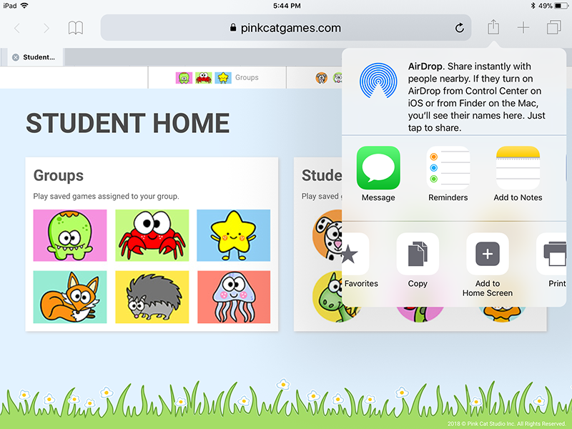
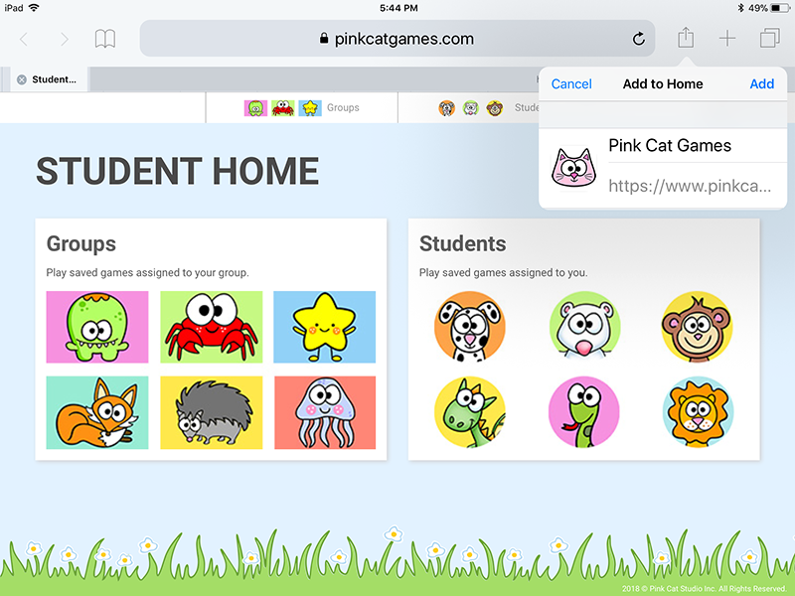
How to Create a Shortcut on an iPad or iPhone
Step 1:
Open Safari on your iPad or iPhone and enter the Student Link provided by your child’s teacher. This will take you to the webpage that your student will use at both school and at home to play their games.
Step 2:
Tap the “share” button on your browser’s toolbar (it’s the rectangle with an arrow pointing up.) You will find this at the top of an iPad screen and at the bottom of an iPhone screen.
A menu will appear. Look for and tap on the “Add to Home Screen” icon. You may need to swipe the black and white icons to show more icons.
Step 3:
Tap the “Add” button and the shortcut app icon will be added to your home screen. You can drag the icon around and place it anywhere, just like your other app icons.

Slide 3
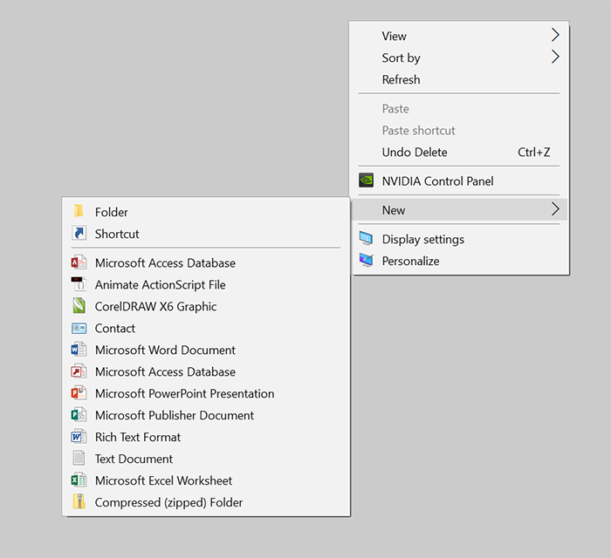
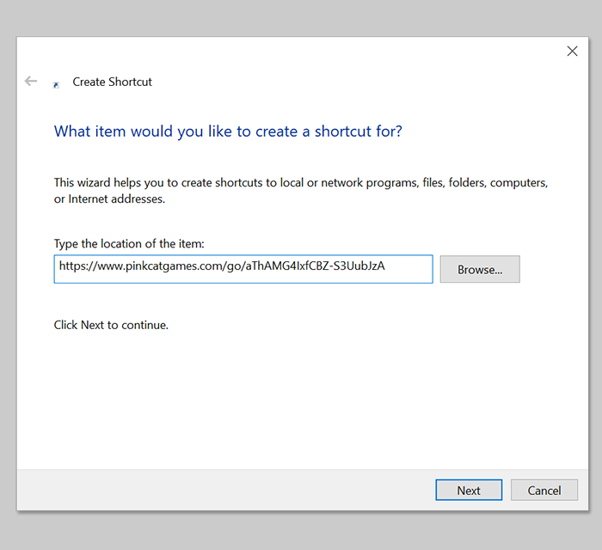
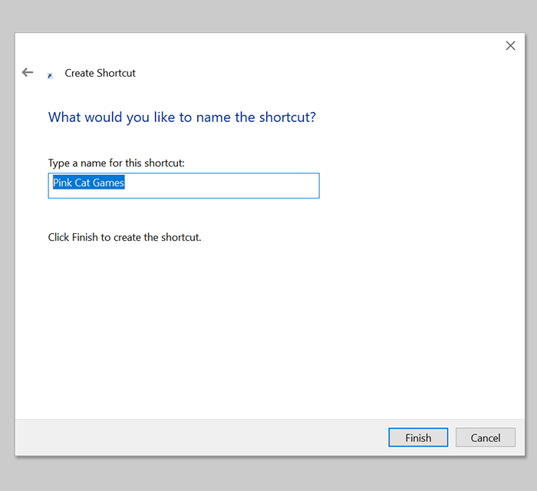
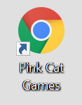
How to Create a Desktop Shortcut on a Windows Computer
Step 1:
Right click on your desktop and choose “New” and then “Shortcut”.
Step 2:
Enter the Student Link provided by your child’s teacher and then click the “Next” button.
Step 3:
Give the shortcut a name such as Pink Cat Games or something that your child will easily recognize and then click the “Finish” button.
The shortcut icon will now appear on your desktop. Your child can double click on the icon to easily get to their games.

Slide 4
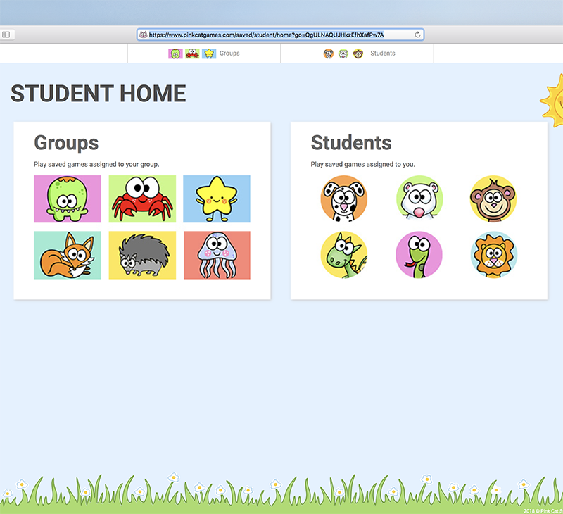
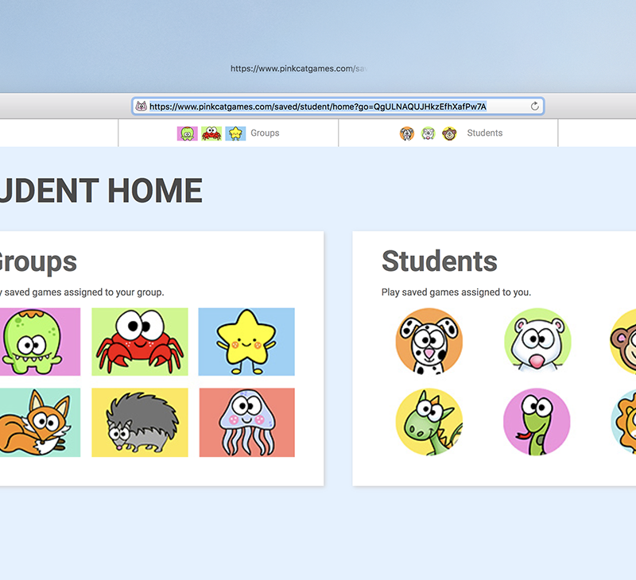
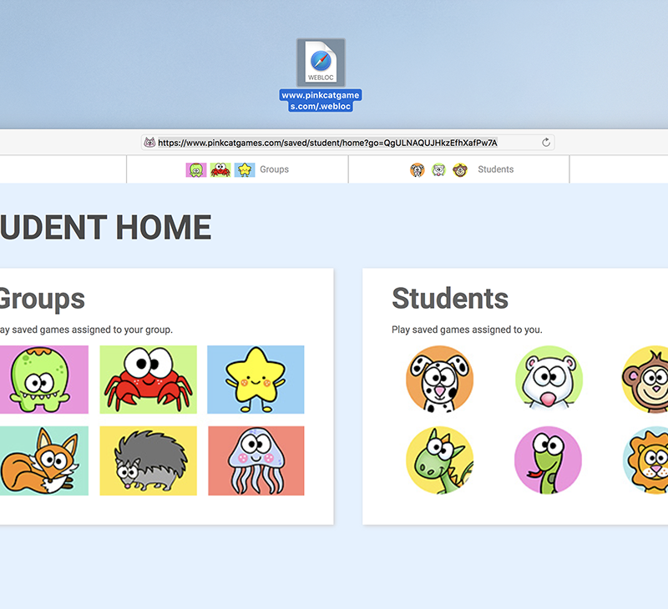
How to Create a Desktop Shortcut on a Mac Computer
Step 1:
Open Safari and enter the Student link that was provided by your child’s teacher. This will open the webpage that your child will use to access their games.
Step 2:
Select the entire address in the address bar at the top of the browser.
Step 3:
Click and drag the address onto the Mac desktop and release the mouse button.
Step 4:
A shortcut icon pointing to the game webpage will be created on the desktop. Your child can double click on the icon to easily get to their games.

